Slide 1

Collisional Modeling of a Plasma
Brynna Neff

Slide 2
Outline
CTH experiment
Nickel project
Goals and limitations of the modelling project
Overview of BOLSIG+
Boltzmann equation and the numerical scheme used
Results
Conclusions

Slide 3
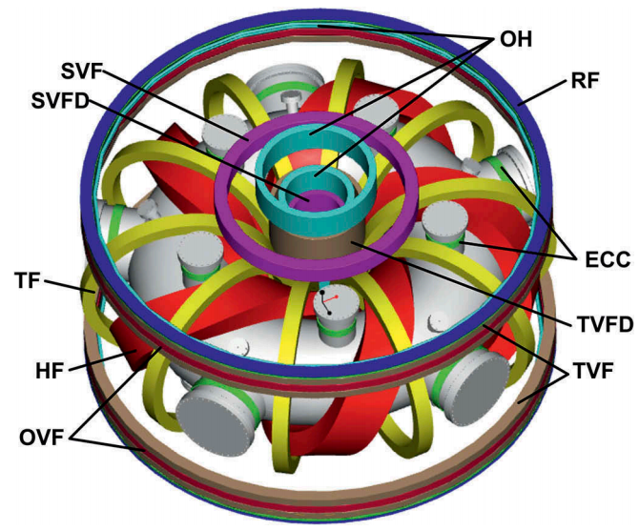
Auburn Compact Toroidal Hybrid (CTH)
Stellarator/tokamak hybrid device
Designed to investigate magnetohydrodynamic instabilities and disruptions in current carrying stellarator plasmas
Maximum magnetic field is 0.7 T
Outer radius is 0.75 meters
Maximum toroidal plasma current is 80 kA
Electron density reaches 2.5*10¹⁸ m⁻³
Electron temperature reaches 200 eV through Ohmic heating

Slide 4
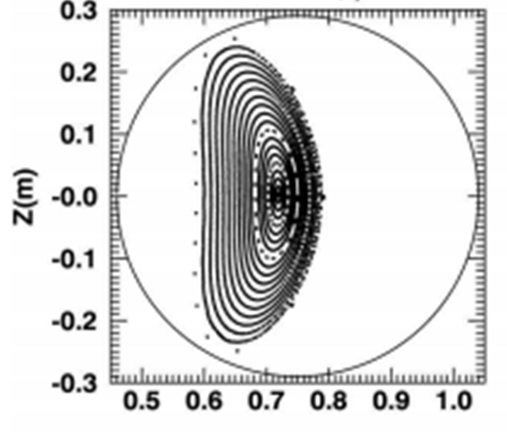
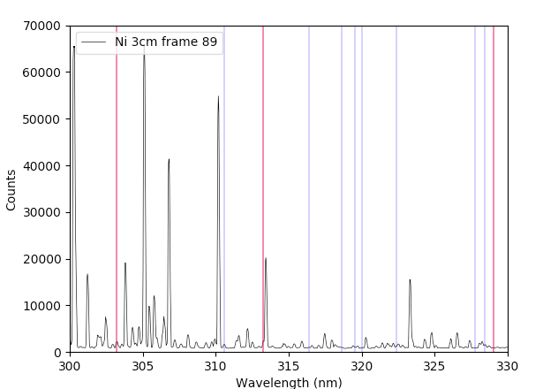
Nickel Experiment
Depths:
0, 3, 6 cm

Slide 5
Goals and Limitations
Aim to better understand the plasma conditions inside the CTH
Run the model with input parameters that are representative of different times within the experiment
Study the behavior of the plasma as the plasma current and electron temperature change over time
Limitations of the program:
Cannot include nickel probe
Magnetic field must be spatially uniform

Slide 6
BOLSIG+
Computer program for the numerical solution of the Boltzmann equation for electrons weakly ionized gases in uniform electric fields
With these conditions, the BE takes the form of a convection-diffusion continuity equation with a non-local source term in energy space, so the program uses an exponential scheme commonly used for convection-diffusion problems
Boltzmann equation shows what the distribution of particles will be among various energy levels as a function of energy and temperature
Main use is to obtain electron transport coefficients and collisional rate coefficient from cross section data
This information can then be used for fluid models of the plasma

Slide 7


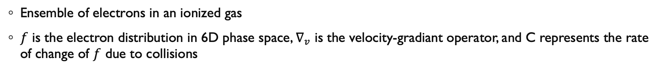
Boltzmann Equation
Ensemble of electrons in an ionized gas
$f$ is the electron distribution in 6D phase space, $∇_{v}$ is the velocity-gradiant operator, and C represents the rate of change of $f$ due to collisions
Using the assumption that the electric field and collisional probabilities are all spatially uniform
Hagelaar, G. J. M. & Pitchford, L. C. 2005, Plasma Sources Science and Technology, 14, 4.

Slide 8
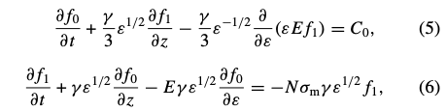


Boltzmann Equation Continued
Expanding $f$ in terms of Legendre Polynomial of $cosθ$ and using a two term approximation
Substitutine (3) into (2) where $γ$is a constant, $ε$ is the electron energy in eV and $σ_{m}$ is the total momentum-transfer cross section
Assumption in order to separate the energy-dependence of $f$ from its dependence on time and space
$F_{0,1}$ is the energy distribution which is constant in time and space

Slide 9






Boltzmann Equation Continued
Using (8) in (6)
From (5), here ${\tilde{C}}_{0}$ is a collision term modified to be independent of density and $\tilde{R}$ is a term to ensure that $F_{0}$ remains normalized to unity
Collisional terms for each type of collision
A₁, A₂, and A₃ are constants

Slide 10
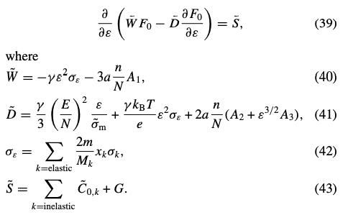
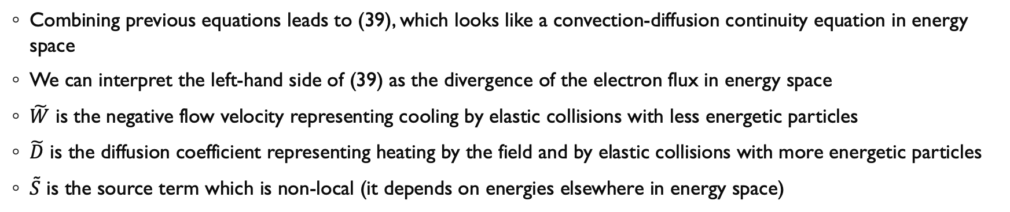
Boltzmann Equation Continued
Combining previous equations leads to (39), which looks like a convection-diffusion continuity equation in energy space
We can interpret the left-hand side of (39) as the divergence of the electron flux in energy space
$\tilde{W}$ is the negative flow velocity representing cooling by elastic collisions with less energetic particles
$\tilde{D}$ is the diffusion coefficient representing heating by the field and by elastic collisions with more energetic particles
$\tilde{S}$ is the source term which is non-local (it depends on energies elsewhere in energy space)

Slide 11



Numerical Scheme
The previous equation is discretized on a grid in energy space
Grid cells are numbered $i=1,2,…$ and $i+\frac{1}{2}$ represents the boundary between the cells $i$ and $i+1$
The energy distribution function $F_{0}$ is defined in the center of the cell
The left-hand side of (44) is discretized by the exponential scheme above
This is a common scheme for convection-diffusion problems
This scheme is very accurate when the convection and diffusion terms are about equal
This happens when inelastic collisions do not play an important role
Becomes equivalent to a second-order accurate central-difference scheme when the diffusion term is dominant

Slide 12

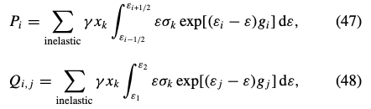
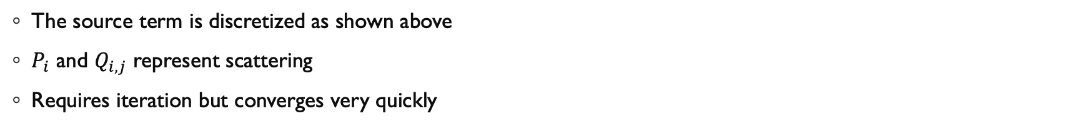
Numerical Scheme Continued
The source term is discretized as shown above
$P_{i}$ and $Q_{i,j}$ represent scattering
Requires iteration but converges very quickly

Slide 13
Results

Slide 14
Results Continued

Slide 15
Conclusions
Analyzed the behavior of collisions as a function of the average electron energy
The total collision frequency and the frequency of elastic scattering conditions increased logarithmically with increasing electron energy
The ionization frequency increased exponentially with increasing electron energy
The frequency of electrons being absorbed by a nucleus increased rapidly until about 7 eV, and then decreased again

Slide 16
References
Hagelaar, G. J. M. & Pitchford, L. C. 2005, Plasma Sources Science and Technology, 14, 4.
Link to paper on BOLSIG+: https://iopscience.iop.org/article/10.1088/0963-0252/14/4/011/meta
Link to BOLSIG+ website: http://www.bolsig.laplace.univ-tlse.fr/

